Slide 1
Session 4–Case Writing and Block Writing
Coach name here

Slide 2
What does a debate case look like?

Slide 3
Definition: A debate case consists of the pre-written arguments both sides reach in their first speeches. They constitute the constructive/offensive arguments for each side in the round.

Slide 4
A debate case builds on some of the ideas we have already learned…
Claim, warrant, impact
Incorporates weighing
Related to the resolution we have already discussed

Slide 5
How to Research for a Debate Case
Utilize reliable sources
Sources that have a cited author and date are often, but not always, more reliable.
Avoid sources with incredibly heavy political bias such as Fox News or Breitbart.
Can utilize both news sources and academic research
Avoid Wikipedia

Slide 6
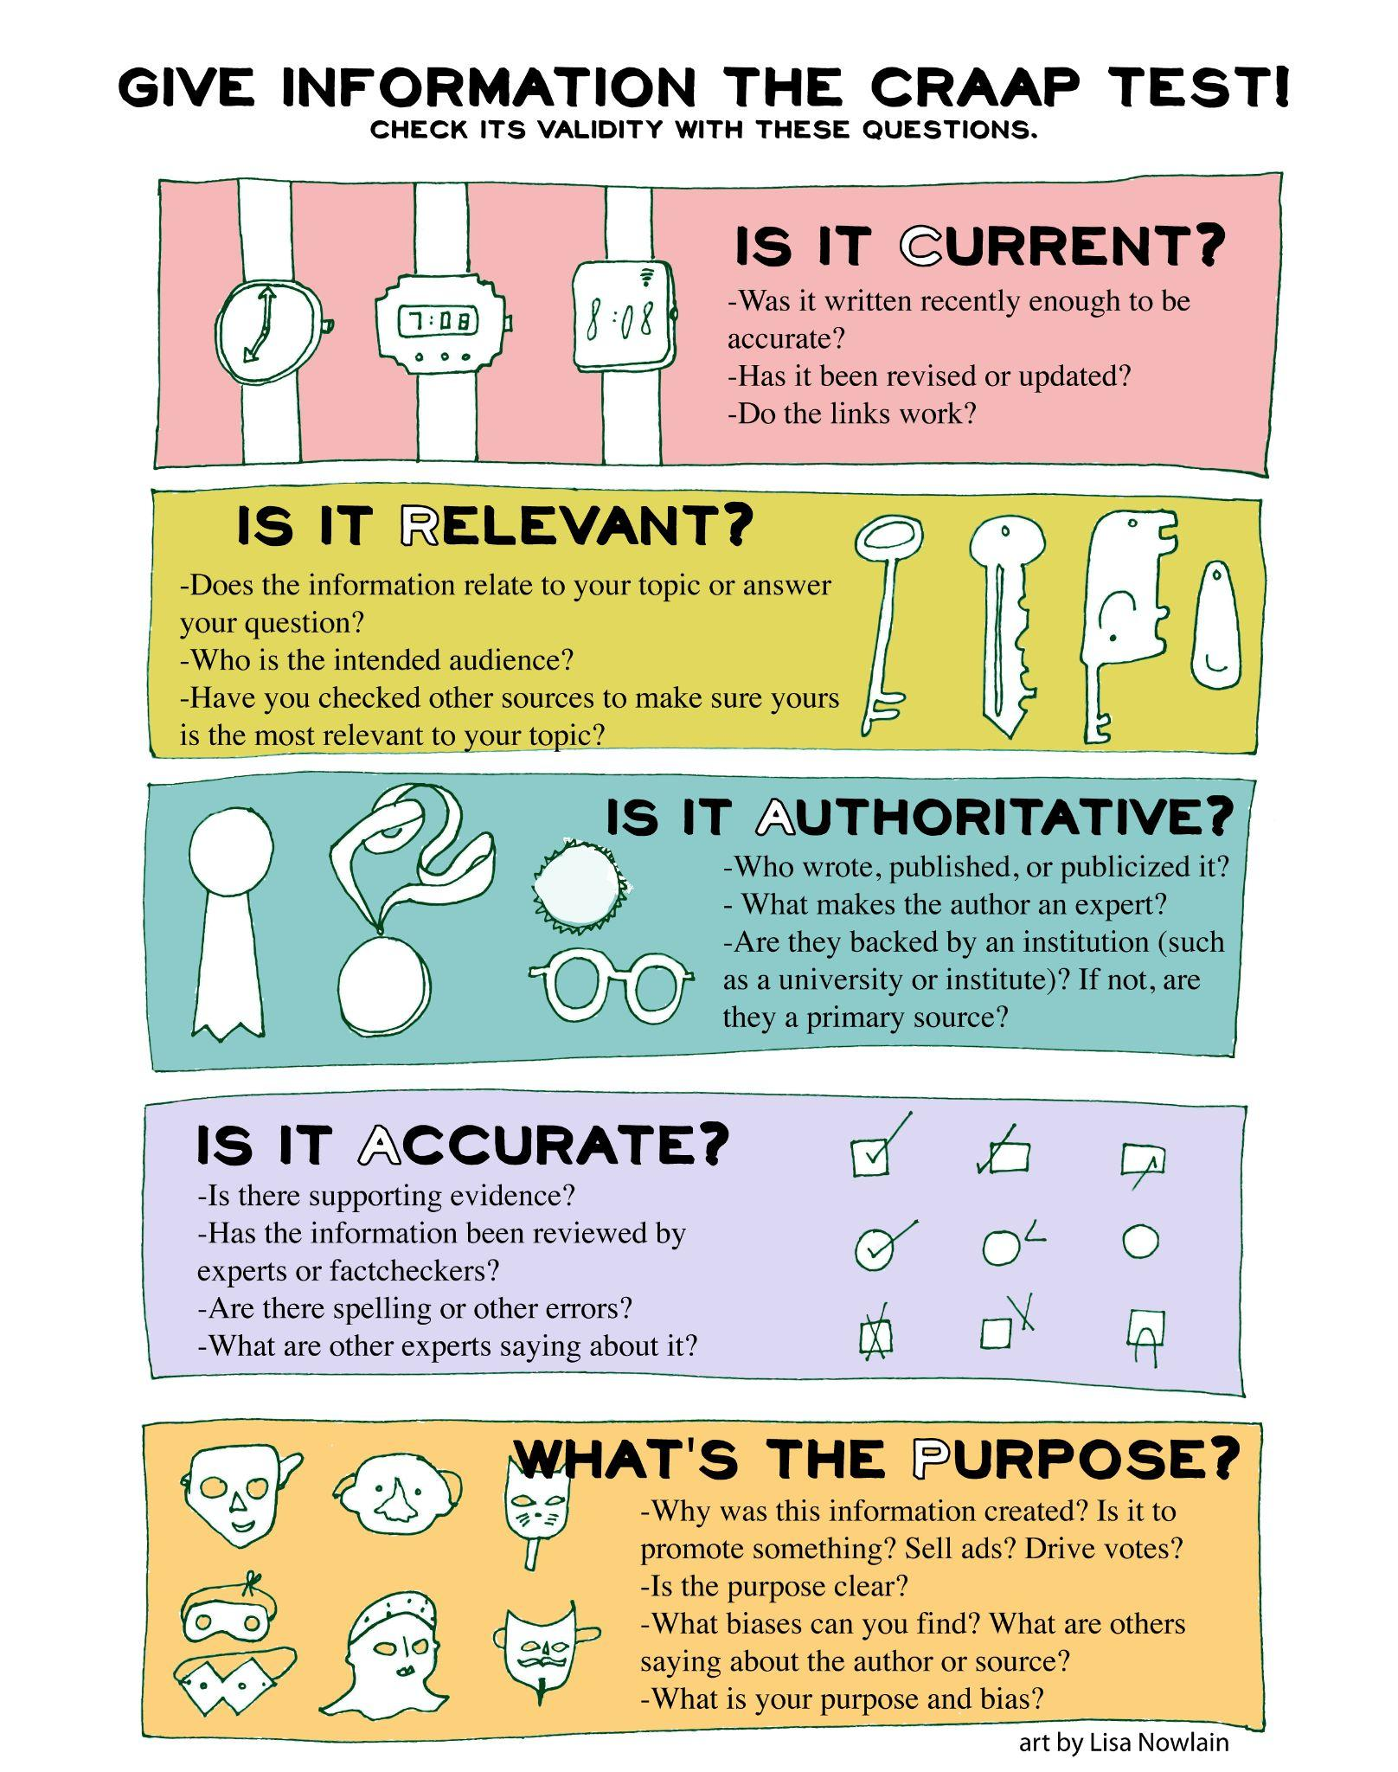
Try out the CRAAP test to determine a source’s validity!

Slide 7
Let’s take a look at a sample outline!
https://docs.google.com/document/d/1QHe5sx6N0NMmlrJeRDTKgXJoMYjbP4UAlXMUTpj1eDI/edit
Notes:
Run through this document and its basic outline of a case with your students. Then.,

Slide 8
Activity: Watching a Speech
Practice flowing ONLY the first speech (unless you do want to watch the whole round!)
Utilizing the case outline, can you all identify the major parts of the case in the first speech in this round?
Note that the first speaker is opposition in this case and the resolution is Resolved: On balance, the benefits of United States participation in the North American Free Trade Agreement outweigh the consequences." (Speech starts around 4:00)
https://www.youtube.com/watch?v=MUnyLbeu7qU&t=254s

Slide 9
Blocks

Slide 10
What are “blocks?”
Blocks are prewritten rebuttal arguments a team may use in a debate to make their rebuttals more organized and thoughtful.
This means that cases are not always the only pre-written arguments in the debate!
Notes:
Reiterate to students why blocks are useful and why, if they have time and energy, they should consider writing them!

Slide 11
What do blocks look like?
Blocks can consist of
Pieces of evidence (cited sources) that refute the other side
Analytical/logical arguments that don’t rely on a cited source
Whatever you want! Whatever you understand and can use best!

Slide 12
Let’s write our own cases!

Slide 13
Reminder of our topic:
"On balance, the benefits of social media to democracy outweigh the harms."
Notes:
Help your debaters pull up a google doc, follow the case outline provided earlier in the lesson, and start flushing out that outline. In other words, provide the skeleton of a case for them that they can further develop on their own.

Slide 14
Affirmative Arguments
Brainstorm some arguments with your students! Type them here.
Notes:
If students cannot come up with any arguments, feel free to provide some yourself.
Feel free to look back at lesson 1 slides and the coach training session #2 slides for the main arguments the curriculum team identified for this topic.

Slide 15
Negative Arguments
Brainstorm some arguments with your students! Type them here.
Notes:
If students cannot come up with any arguments, feel free to provide some yourself.
Feel free to look back at lesson 1 slides and the coach training session #2 slides for the main arguments the curriculum team identified for this topic.

Slide 16
Block/Rebuttal Arguments for the Aff
What could aff say in response to some of the negative arguments we just discussed?
Notes:
Again, feel free to help students on this as much as they need.

Slide 17
Block/Rebuttal Arguments for the Neg
What could neg say in response to some of the constructive affirmative arguments we discussed?
Notes:
Again, feel free to help students on this as much as they need.

Slide 18
If time allows…
Students may either:
Finishing watching the round that was started earlier in the lesson, including flowing all of its arguments, critiquing the round/giving feedback, and deciding who the class thought won the debate!
https://www.youtube.com/watch?v=MUnyLbeu7qU&t=254s
Do a spar debate!
Same format as last time–aff/neg constructive (2 minutes), Crossfire 2 minutes, prep time 2 minutes
Choose a topic here: https://vipspeech.yolasite.com/resources/SPAR%20Topics%20(Week%20One).pdf

Slide 19
Thanks for listening!

